Slide 1
Imagine your future …
Notes:
Before we get started today, close your eyes and take just a moment to think about the future. PAUSE Some of you are probably thinking about what’s for dinner or an upcoming weekend outing. Maybe you’re envisioning the next family gathering or vacation you have planned. But stretch your mind and go further … and imagine your life in retirement.
[Pause for a moment]

Slide 2
Notes:
Does your vision include you enjoying your golden years with confidence, traveling, spending time with loved ones, mastering a favorite hobby and maybe even just enjoying some quiet time to relax?

Slide 3
Notes:
Surely it doesn’t include suffering through troubling retirement realities that could plague your post-career adventures. But the reality is, a number of roadblocks may be standing in your way to achieving the retirement you desire and deserve.

Slide 4
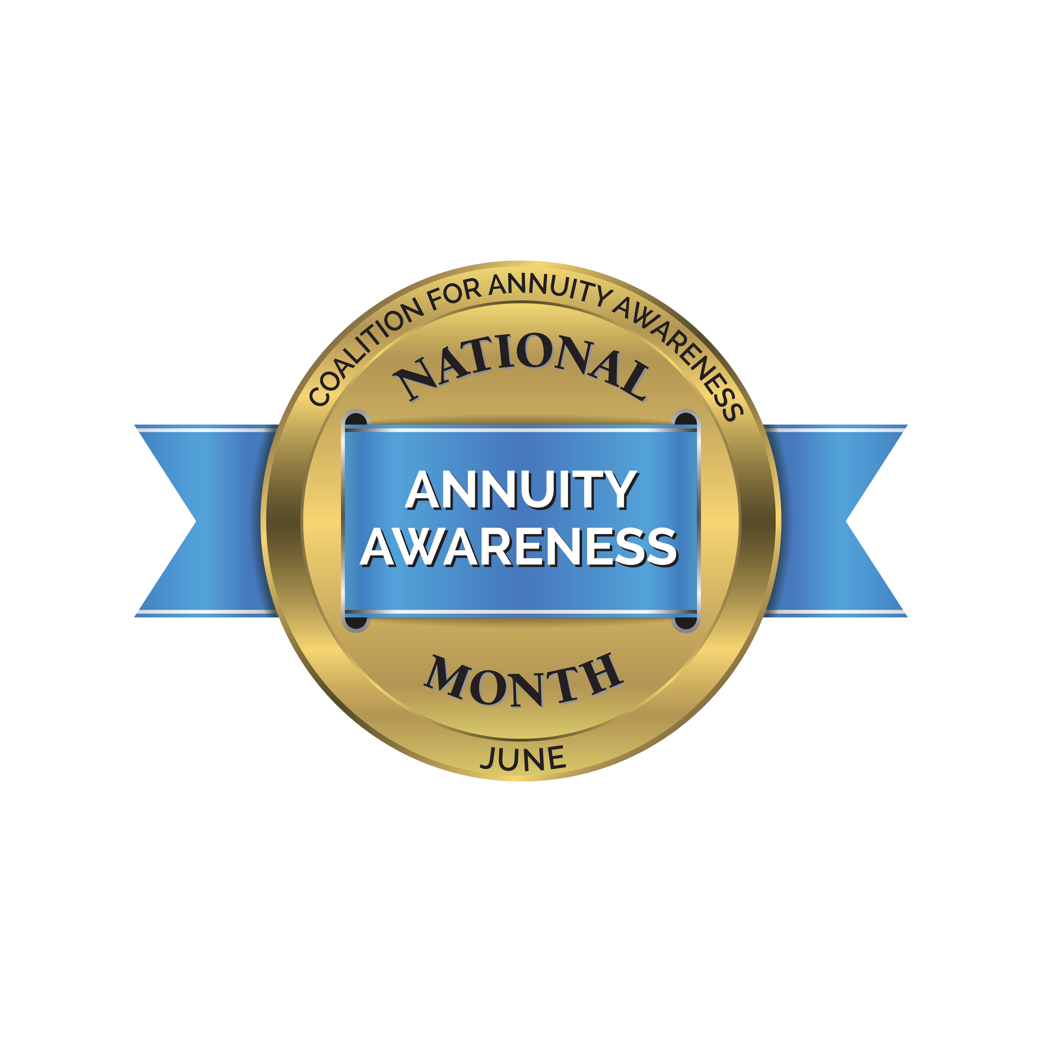
Presented by
Producer’s Name
Company
Disclosure Here As Needed
Notes:
Hello, and thank you so much for joining me today! My name is
PRODUCER NAME, TITLE and COMPANY NAME.
THEN DELIVER A SHORT BIO ABOUT YOURSELF.
Today I’m going to spend about 20 minutes walking you through the complexities of securing your retirement, highlighting 8 specific roadblocks that could throw you off course and some strategic tips for avoiding them.
MENTION YOU ALWAYS OFFER A COMPLMENTARY FOLLOW UP MEETING TO ANSWER PEOPLE’S PERSONAL QUESTIONS AND YOU’LL TELL THEM MORE ABOUT THAT LATER
LET THEM KNOW YOU’LL ASK THEM TO COMPLETE EVAULATION FORM ABOUT YOUR PRESENTATION IF YOU’RE DOING ONE. THEN SAY…
Several times a year I deliver presentations like this for my clients and other select individuals.
As a financial professional, I believe it’s important to educate people about personal finance and retirement so they can best determine how to save money, grow their money and make it last. Unfortunately, that’s becoming more and more challenging due to …

Slide 5
The Certainty of Uncertainty
"In this world nothing can be said to be certain, except death and taxes.”
— Benjamin Franklin
Source: EBRI/Greenwald Research Retirement Confidence Survey 2021
Notes:
A changing retirement landscape. We’re all familiar with the saying that death and taxes are the only guarantees in life. That’s because in this day and age, the certainty of retirement, historically represented by the three-legged stool of pensions, savings and Social Security, is uncertain for many Americans. With the demise of traditional pensions, the questionable future of Social Security and 34% of Americans reporting savings of less than $50,000 for retirement¹, we’re collectively having to rethink the way we strategize about preparing for life after work.
In addition to these circumstances, I’ve found throughout my years of service in this industry that there are eight roadblocks consistently causing clients to stumble along the journey to the “golden years” they’ve long dreamed of. Let’s examine these in more detail and how to successfully navigate any impacting your life and future plans.
⁻⁻⁻⁻⁻⁻⁻⁻⁻⁻⁻⁻⁻⁻⁻⁻⁻⁻⁻⁻
¹ EBRI/Greenwald Research Retirement Confidence Survey 2021

Slide 6
Roadblock #1: Failure to Plan
Source: Protected Lifetime Income Index Survey, Alliance for Lifetime Income, July 2019
Notes:
First, let’s talk about the obvious. In fact, this may be part of the reason you’re here joining me for this presentation today: a failure to plan. According to a recent survey conducted by the Alliance for Lifetime Income:
Only two out of 10 people, 20%, have an organized retirement plan that they closely follow.
The remaining 80% either don’t have a plan (25%), have goals or direction but not a well-developed plan (35%), or have a plan but say it doesn’t go far enough (20%).
And let me tell you, if the plan is a loose set of ideas that exist only in your mind, that is simply not enough. A written plan can make it easier to track your progress, hold yourself accountable and proactively identify any tweaks you need to make to ensure you stay on track over time as your needs change and your life unfolds. As you craft your written retirement plan, it’s important to …

Slide 7
Roadblock #2: Focusing Only on Finances
Financial Health
Mental Health
Emotional Health
Notes:
Avoid letting the plan have a singular focus: finances. After all, the keys to a successful retirement include much more than just financial stability. For those folks who do have a plan in place, how many have expanded their plan to move beyond money and instead encompass all aspects of life in retirement? Critical questions you may need to ask yourself include:
Where will you live?
How will you spend your time?
How will you stay healthy?
What do you need to do to prepare emotionally?
How will you utilize your savings effectively to find fulfillment?
Some retirees are so used to their career routines that they feel lost when transitioning and acclimating to a retirement lifestyle. It’s imperative that well before you say goodbye to your “old life,” you think through how and where you will spend your time and energy in this new phase. It’s also critical that your plan marry your focus on retirement savings and account balances with the activities, hobbies and bucket list items that this funding is intended to cover that will deliver a sense of personal fulfillment. This will allow you to use your time in retirement wisely and efficiently, not only financially but mentally and emotionally as well. And by making this self-care a priority, you may have a better chance of maintaining the health and wellness that keep the cycle of fulfillment turning.

Slide 8
Roadblock #3: Taking on Too Much Burden
Too much financial love …
Could lead to serious heartache.
Notes:
[click] Regardless of age and stage of life, it’s hard for many parents and couples to imagine doing anything other than taking care of their families to the best of their abilities. Yet as a financial professional, I’ve seen it too many times: Parents with grown children who still depend on them for everyday living expenses and others who are paying off their children’s student loans. Some parents loan their kids money at low or no interest, or agree to co-sign on a car loan or mortgage. Parents may gift money to their children without fully thinking through the consequences … and then come up short on what they need for themselves early or later in retirement. [click] Like most scenarios, it’s true that there could be too much of a good thing.
Just as when you fly they tell you to put your oxygen mask on first, that should be a rule for parents when it comes to gifting or lending money to their children. Always make sure your financial position is OK first – whether you’re still saving for retirement or you’re already there. After all, ensuring you have the funds to sustain yourself in every phase of life and not becoming a burden on loved ones is one of the greatest gifts you could give your children.

Slide 9
Roadblock #4: Overexposure to Risk
Identify your risk tolerance
Compare your comfort level with your plan
Monitor and adjust as you age
Notes:
With your social, emotional and family dynamics addressed, let’s start to really focus on financial positioning roadblocks impacting many of you at or nearing retirement. First and foremost, it’s important to truly understand how your assets are positioned and whether that positioning matches your profile as an investor.
[click] Start by identifying your current risk tolerance. How comfortable are you with having assets exposed to the ups and downs of the market? Next, [click] compare that risk tolerance level with how your savings is currently positioned. When the markets are up, it can be easy to overexpose yourself in an effort to capture as much upside as possible. But we know that what goes up must come down. And if you don’t have a portion of your nest egg properly protected, you could suffer from serious consequences of a downturn. Once you have allocated the appropriate amount of your savings to the types of assets that match your risk tolerance, [click] you’ll want to monitor the plan and make adjustments as you age. The nearer you get to retirement, the more you may find your risk tolerance declines. If so, you’ll want to continue shifting portions of your savings into principal-protected vehicles that help you protect what you have worked so hard to build throughout your working years.
Let’s expand a little more on the idea of protection from uncertainty …

Slide 10
Roadblock #5: Ignoring the Unknowns
Market Swings
Longevity
Inflation
Health Concerns
Sources: Social Security Administration 2021 Sample Statement and Life Tables for the United States Social Security Area 1900-2100; U.S. Department of Health and Human Services: Genworth 2020 Cost of Care Survey
Notes:
By talking about our next roadblock: ignoring the unknowns that could alter or even derail even the best-laid retirement plans. [click] As we just discussed, no one can predict where the market is headed or when the cycle from bull market to bear market and back will turn. If you don’t proactively have a portion of your nest egg protected in every market environment, you could be headed for trouble.
[click] Beyond the market, today’s retirees are facing increasing longevity — meaning we’re living longer. In fact, according to the Social Security Administration, in 1940, the life expectancy of a 65-year-old was 13 years; today, it's over 18 years,¹ and one in 10 retirees will live to age 95²! Living longer means our assets need to last longer to secure retirement income needs.
[click] We also must consider the potential for rising inflation. As the price of consumer goods continues to rise, you’ll want to ensure your calculations don’t just work for today, but that they take into account the value of your money in and throughout retirement.
[click] And finally, we can’t forget about the need to protect ourselves from any potential care needs in retirement and the costs associated with them. In fact, according to the U.S. Department of Health and Human Services, nearly 7 in 10 adults reaching age 65 will need long-term care.³ The Genworth 2020 Cost of Care Survey indicates that the monthly median cost of a full-time home health aide would cost $4,576, $4,300 per month for assisted living care and nearly $9,000 a month for a private room at a nursing home facility.⁴ If you haven’t addressed any of these potential uncertainties in your plan, you still have work to do to keep yourself, your family and your future protected.
--------------
¹ Bell, Felicitie C. and Michael L. Miller. Life Tables for the United States Social Security Area 1900-2100, Study 120, available online at https://www.ssa.gov/oact/NOTES/as120/LifeTables_Tbl_10.html
² Social Security Administration 2021 Sample Statement, available online at https://www.ssa.gov/myaccount/assets/materials/SSA-7005-SM-SI%20Wanda%20Worker%20Near%20retirement.pdf
³ U.S. Department of Health and Human Services, available online at https://longtermcare.acl.gov/the-basics/how-much-care-will-you-need.html
⁴ Genworth Cost of Care Survey 2020, available online at https://www.genworth.com/aging-and-you/finances/cost-of-care.html

Slide 11
Roadblock #6: Overreliance on Social Security
Trust funds will be depleted by 2035 and benefits may decrease
An influx of new Social Security claimants may deplete funds as early as 2029
Sources: 2020 annual report of the Social Security Board of Trustees, “Covisum Launches Social Security Benefit Cut Calculators” news release issued April 6, 2021
Notes:
Earlier we spoke about the historical three-legged stool retirees had used as a means for creating income to fund retirement. Let’s dive into what’s happening with one wobbly leg of that stool: Social Security. According to the 2020 annual report of the Social Security Board of Trustees, [click] the surplus in the trust funds that disburse retirement, disability and other Social Security benefits will be depleted by 2035. For years, this projection has been a talking point of our industry as we wait to see what the federal government might do to help extend the life of this critical retirement benefit for Americans. But if action isn’t taken, how would your income plans be impacted?
What’s even more concerning, a recent announcement from Covisum, a retirement software company, suggests that throughout the pandemic, many people have decided to claim their Social Security benefits early because of market volatility and high unemployment. [click] The influx of new Social Security claimants, in addition to the reduced income from fewer people working, has some experts estimating that the Social Security system will run out of funds as early as 2029 – rather than that 2035 date the most current Trustees report indicates. This potential roadblock is one that makes it clear alternative income plans must be in place to ensure you can maintain your preferred standard of living with or without a Social Security paycheck.

Slide 12
Roadblock #7: Focusing on Assets, Not Income
Accumulation >> Preservation >> Distribution
Accumulation >> Preservation >> Distribution
Accumulation >> Preservation >> Distribution
Accumulation >> Preservation >> Distribution
Notes:
Let’s explore this conversation about income further. We talked about the importance of having a plan, and making sure that plan is documented. But it’s also important that plan include a specific income plan. In other words, how will you make your money last as long as you do in retirement?
Some people get so caught up in growing their money they forget to protect what they have, especially as their life evolves and they find themselves in or near retirement. Currently, as we’re experiencing historic low interest rates, and the Fed has communicated we can’t expect that to change any time soon, many investors are flocking to the markets to capture some of its upside. But remember, an ill-timed market drop could leave you overexposed and under protected.
We start to avoid this roadblock by recognizing the three phases of money. [click] First, during your working years, you’re in the accumulation phase, where your risk tolerance can be more aggressive because you have time to recover from any major downturns. As you begin nearing retirement, you’ll want to consider preserving a portion of your nest egg from potential declines. [click] Once you transition into retirement, you need a solid plan for distribution, or how you’ll use the funds you’ve accumulated and preserved to sustain you when you’re no longer receiving income from traditional methods. Understanding when and how much money to withdraw and from which accounts is critical when you’re counting on a stress-free and enjoyable retirement.

Slide 13
Roadblock #8: Going It Alone
Have financial plans built to endure market ups and downs
73% working with financial advisor
30% without a financial advisor
Feel very financially secure
66% working with financial advisor
31% without a financial advisor
Source: 2019 Planning and Progress Study, Northwestern Mutual
Notes:
Finally, we’ve reached our last planning roadblock. In the age of Google Reviews and YouTube tutorials, many people approach retirement planning as a DIY task. Yet building on the importance of planning that we have discussed throughout this presentation, data repeatedly indicates that there is significant value in planning with the help of a professional. In fact, a recent study from Northwestern Mutual noted two critical findings: First, 73% of those working with a professional believe their plans are built to weather the ups and downs of the market, whereas only 30% of those planning alone have that confidence. And second, more than twice as many savers working with a professional claim to feel very financially secure. Getting professional insights and planning advice from those who are trained and licensed to help you make decisions in your best interest can have a valuable impact on your future and make it easier to reach your financial and lifestyle goals.

Slide 14
A Simple Strategy Can Help
Annuity (noun)
an·​nu·​i·​ty | \ ə-ˈnü-ə-tē
An insurance contract designed to pay out a fixed income stream
Notes:
As a professional committed to helping enhance and secure the future for my clients, I’d be remiss not to mention a strategy at this point in the presentation that could help address a number of these roadblocks on your road to retirement. An annuity is an insurance contract designed to pay out a fixed income stream for life, no matter how long you live. Specifically, fixed and fixed index annuities can do so while helping you …

Slide 15
Navigate Key Risks with Confidence
The risk of outliving your savings.
The risk of reduced purchasing power in the future.
The risk of market losses early in retirement that your portfolio may not recover from.
Notes:
Navigate three key retirement risks with confidence. First, the risk of outliving your savings. As I just mentioned, annuities can help you position a portion of your assets to generate predictable income to help you cover basic expenses and/or supplement other income sources that make it easier to secure your future. Second, annuities can help address the risk of reduced purchasing power in the future, which we covered earlier. Some annuity solutions feature options such as inflation-based provisions, either built into the contract or available for an additional fee, that can help mitigate this risk. And finally, fixed and fixed index annuities can help you protect your savings from market losses that could derail your retirement because they feature a zero floor — in other words, you cannot lose money due to market losses.

Slide 16
Take Their Word for It
“I can worry less about day-to-day expenses in retirement.”
“It gives me wiggles room to spend more on discretionary spending than I would have otherwise.”
“I appreciate being able to budget more effectively.”
“It provides the promise of protecting me against running out of money should I live a long time.”
May not be representative of the experience of other annuity customers.
Source: Fifth Annual Guaranteed Lifetime Income Study (GLIS), Greenwald & Associates and CANNEX, June 2019
Notes:
You may be listening to these points and wondering, “Is an annuity right for me? Or is HE/SHE just saying that to try to make a sale?” The truth is, I want you understand the value of having an annuity so you can reach your specific retirement goals, and to help you with this education, I encourage you to not just take my word for it.
[click] According to the results of the Fifth Annual Guaranteed Lifetime Income Study, here are a few things that actual annuity owners have to say about the benefits and value of annuity solutions. First and foremost, annuity owners cite protection against running out of money as the most compelling reason to purchase an annuity. Beyond that, many of their responses tie directly into the emotions that ownership can bring. From less worry to greater confidence and flexibility, these feelings are indicative of the importance annuity products can play in future planning.

Slide 17
Guides on the Retirement Journey
Familiarity with annuities
Having a financial professional
Discussing income strategies with a financial professional
Age
Source: Sixth Annual Guaranteed Lifetime Income Study (GLIS), Greenwald & Associates and CANNEX, June 2020
Notes:
So what makes one choose to move forward and make annuities part of their long-term retirement income plans? Based on a regression analysis, the Sixth Annual Guaranteed Lifetime Income Study identified four factors that drive guaranteed lifetime income annuity ownership, which can be helpful guides on your retirement journey.
[click] First, familiarity with annuities. Through exposure, education and word-of-mouth anecdotes from other satisfied owners, individuals can better understand annuities and how they might fit into a comprehensive retirement plan.
[click] Second, having a financial professional. Annuity owners are more than twice as likely to be working with licensed professionals than non-owners.
[click] Third, income planning discussions with financial professionals. Consumers and financial professionals agree that estimates of retirement income are more helpful for retirement planning than savings goals or estimates of retirement expenses, even though all are clearly linked. Yet, only 38% of consumers say a financial professional has provided them with this estimate.
[click] The final factor was age. Those 65 to 75 were significantly more likely to own annuities than those 55 to 64.
As you think about your specific financial situation, these factors may be weighted differently in your decision-making, but they can all be valuable in thinking about where you are and where you want to be in your future planning at various stages.

Slide 18
Get Educated about Annuities
Notes:
As you think about the retirement planning roadblocks we’ve discussed and the potential for incorporating annuities into your plan, I want to share with you a helpful resource you can use that summarizes the value of these powerful solutions in the context of planning in 2021. At the conclusion of this presentation, I’ll be sure that each of you receive a complimentary copy of my 7 Reasons to Consider Annuities in 2021 simply for attending today as a handy tool for furthering your education about financially savvy strategies for meeting your secure retirement savings and lifetime income goals.

Slide 19
How did I do?
How can I help?
Notes:
MENTION YOU ARE DISTRIBUTING EVALUATION/APPOINTMENT SETTING FORMS AND ASK FOR THEM TO PROVIDE FEEDBACK IF APPLICABLE. IF NOT, DELETE THIS SENTENCE.
[click] In addition to giving you a few minutes to complete this form, I want to open up the conversation to questions. I know we’ve covered a lot today, and if something is unclear or I can help provide additional detail, I’m sure the entire audience can benefit from your thoughts.
We’ll also reach out to you individually for more tailored follow-ups and to schedule personal appointments for those of you interested.

Slide 20
Thanks for your time!
Name
Company Name
xxx.xxx.xxxx
email@companyname.com
Notes:
I want to again thank you for joining me today for this look at the complexities of retirement planning, and I hope you can take the information provided to elevate your personal awareness of these eight roadblocks that may be impacting your planning journey. If you are interested in evaluating ways to better meet and secure your retirement, I would welcome the opportunity to meet with you personally to discuss strategies that may be right for your unique financial circumstances. Being armed with the educational information you need to get started is a wonderful building block for preparation, and I hope you can walk away from this discussion feeling empowered to take the next steps. Have a great rest of your day, and I hope to talk with you soon!

Slide 21
Disclaimers
This material has been prepared for informational purposes only. Agents may not give tax, legal, accounting or investment advice. Individuals should consult with a professional specializing in these areas regarding the applicability of this information to his/her situation.
Annuities are long-term products designed for retirement purposes. Annuity guarantees are backed by the financial strength and claims-paying ability of the issuing insurance company.
Partial withdrawals reduce the cash value and certain benefits, such as the death benefit amount. Early withdrawals may be subject to withdrawal charges.
Distributions, when withdrawn, are subject to federal and/or state income tax, including a 10% tax penalty for withdrawals before age 59½.
Some income guarantees offered with annuities take the form of optional riders and carry charges in addition to the fees and charges associated with annuity products.

